Slide 2
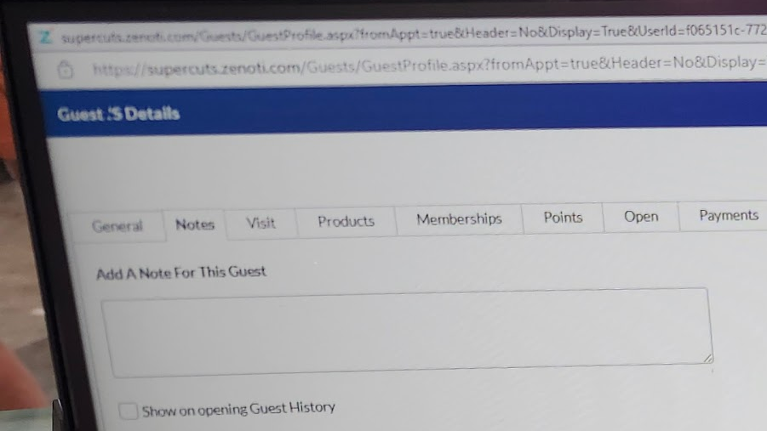

Slide 4
(username : prefrenceString)
(username : [haircutBool, sideInt, topInt, neckInt, styleString])

Slide 5
Get Method
Open database.csv
For each line in database
localDatabase.update(name, [haircutBool, sideInt, topInt, neckInt, styleString)

Slide 6
Return Method
Open database.csv
For each line in localDatabase
database.update(name, [haircutBool, sideInt, topInt, neckInt, styleString)

Slide 7
Adding Method
database.update(name, [haircutBool, sideInt, topInt, neckInt, styleString])

Slide 8
Update Method
tempFile [] = database(name)
Userinput [haircutBool, sideInt, topInt, neckInt, styleString]
For item in temp file
If tempfile[item] isn’t blank
Update database[item] to be tempifle[item]
Delete tempFile

Slide 9
Final Program Code
Name = input ()
GetDatabase()
Try Display LocalDatabase (Name)
If that didn't work
Display not in system Message
Try LocalDatabase (Name)
update()
If that didn't work
add()
return()

Slide 10
Input Validation Types
Names
Integers
Bools
Strings
Blank Strings
Non Numbers, Decimals, and Negatives
Anything Not True of False
Nothing

Slide 12
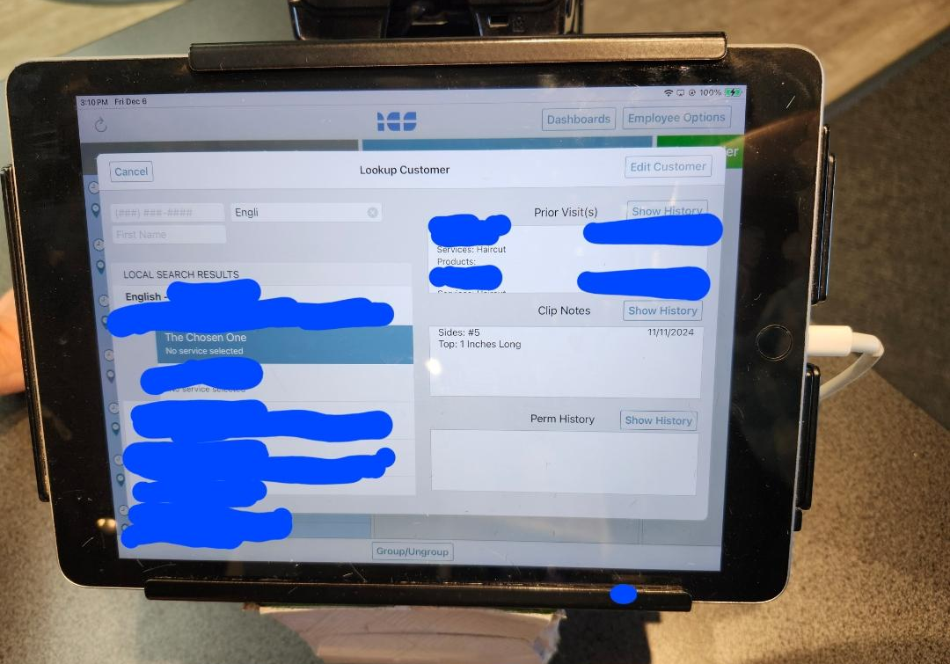

Slide 14
Citations
English, J. K., & Avila, Estella (2024, December 6). personal.
English, J. K., & Smith, Rosalind (2024, December 7). personal.
English, J. K., & Morales, Vyanka (2024, December 7). personal.
English, J. K., & Kendall, Emily (2024, December 7). personal.

